Slide 1

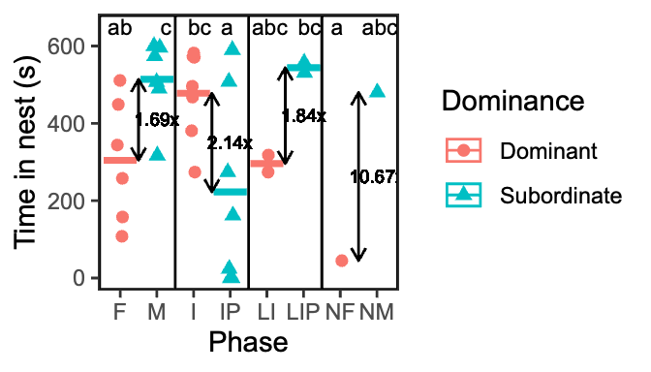
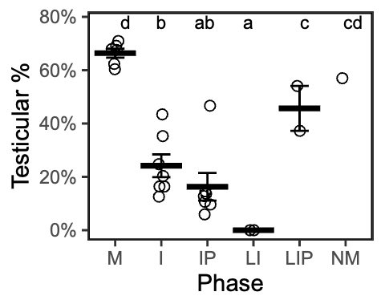
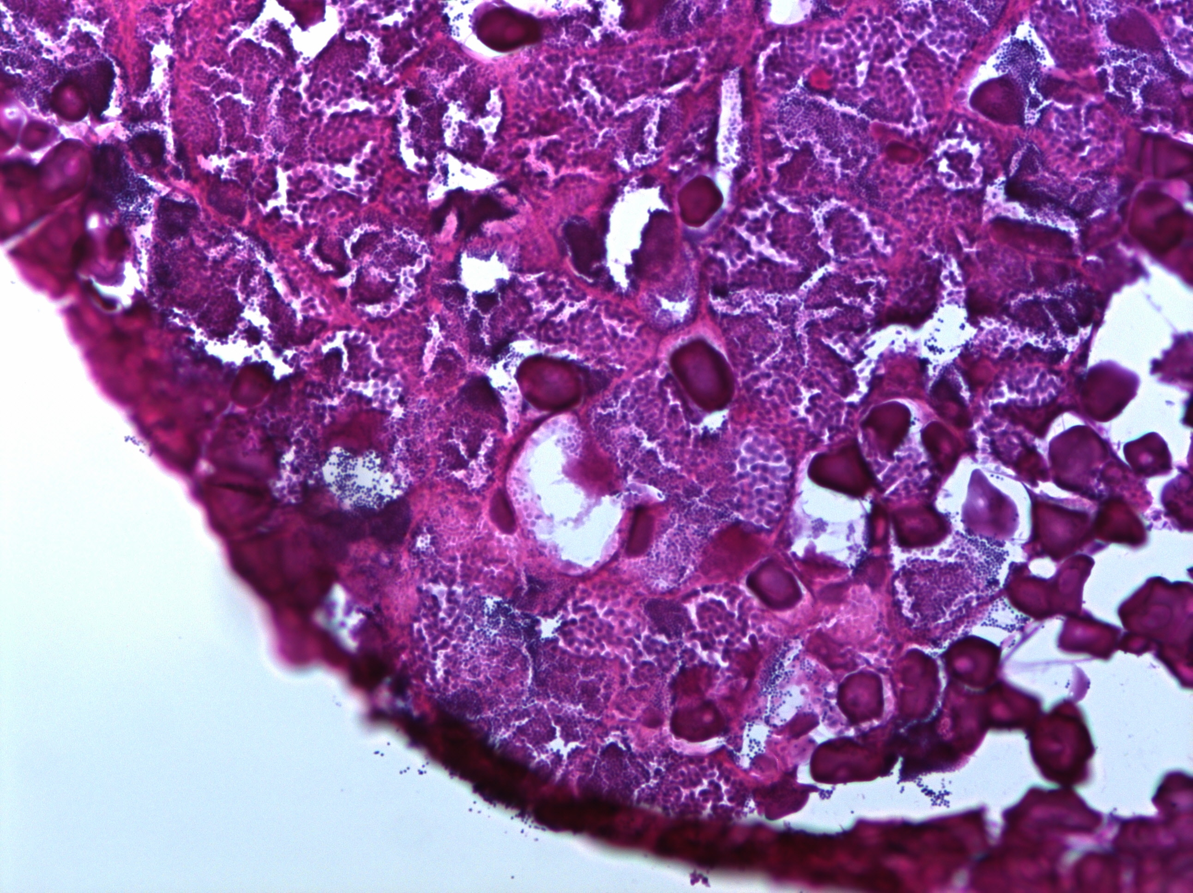
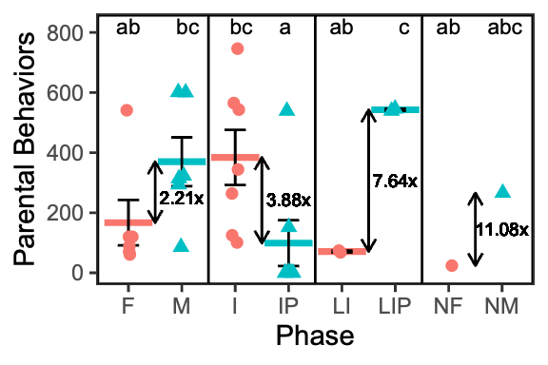
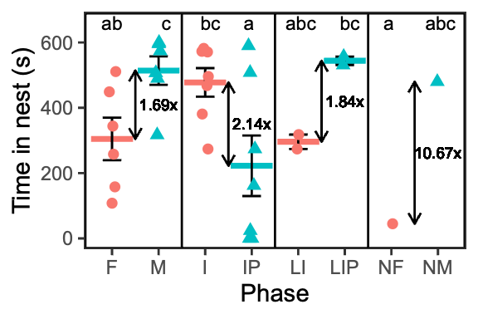
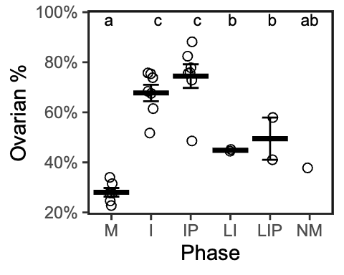
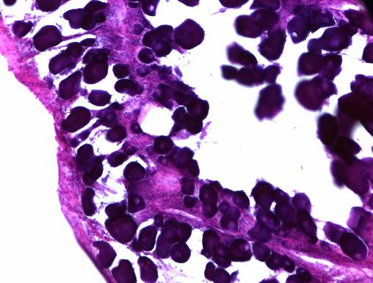
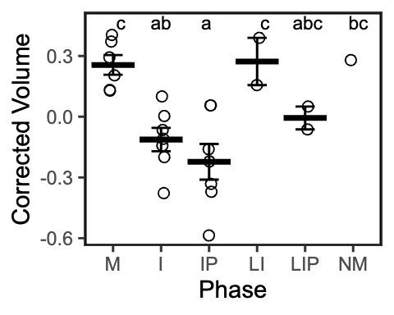
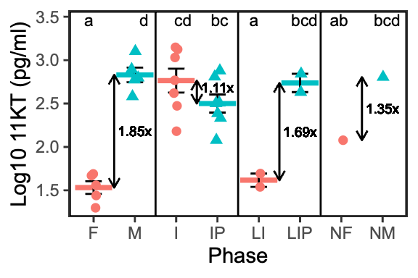
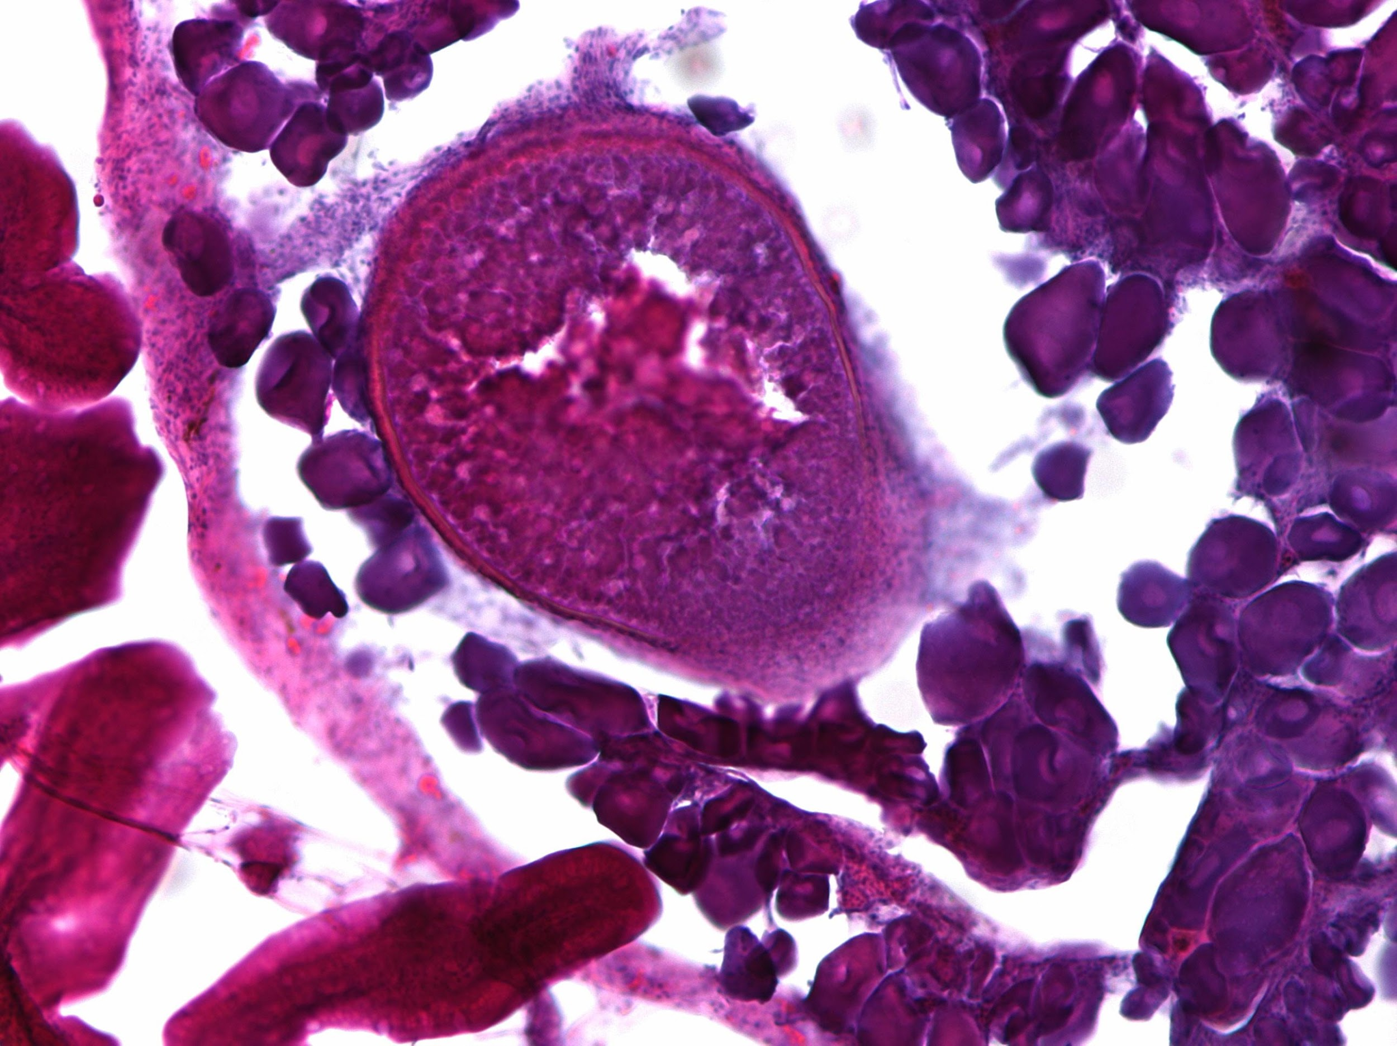
a
♂
I
♀
♂
IP
♂
a
Pairing
6 Months
Sampling
6 Months +
Sex Change
↑ Neurogenesis
Growth, Testicular Degeneration
↓ 11-KT
↑ E2
Oogenesis
↑ Aggression
↓ Parenting
b
c
d
Male
Late Intermediate
Female

Slide 2
♂
I
♀
♂
IP
♂
Pairing
6 Months
Sampling
6 Months +
Sex Change
↑ Neurogenesis
Growth, Testicular Degeneration
↓ 11-KT
↑ E2
Oogenesis
↑ Aggression
↓ Parenting
♂
♀
Maybe we use this symbol?

